Slide 1
EDA for Case Study 3
By
Nilesh Nerkar
Abhinav Tiwari
Dharit Shah

Slide 2
Agenda
Variable Description
Missing Value Analysis
Dataset Information
Summary Statistics
Numeric Quantities Analysis
Interdependency between data using Correlation Matrix
Time Series Analysis of Appliance Energy Consumption
Variable Importance Plot after modeling

Slide 3
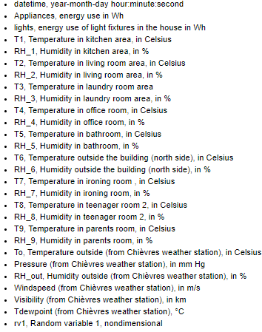
Variable Description
T stands for temperature and RH is used for the room humidity

Slide 4
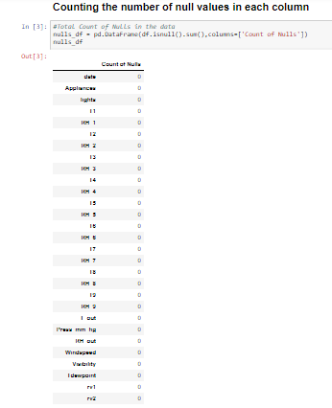
Missing Value Analysis
We can see from the above results that the data does not have any nulls in any of the columns, hence we can proceed with our analysis

Slide 5

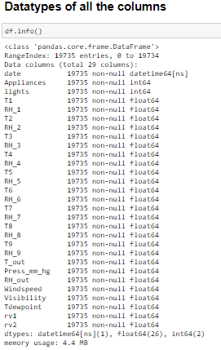
Dataset Information
There are in all 29 columns in the data set and 19735 rows
The datatype of all the columns are as required and we do not need to modify them

Slide 6
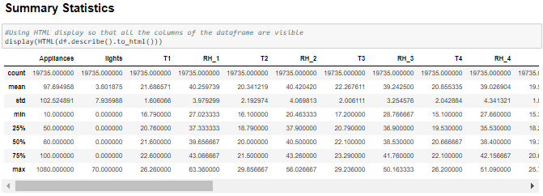
Summary Statistics
- Almost 75% of the data in the lights column is 0, it is unclear whether the value is intentionally 0 or unknown
- Looking at the 50% percentile and the mean we assume there are no outliers for the features provided except for the variable "Appliances"

Slide 7
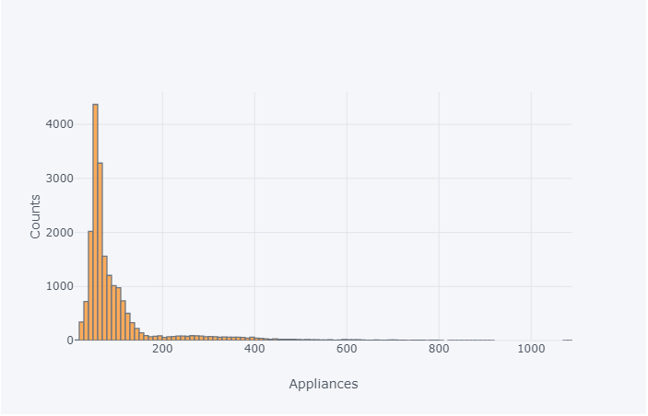
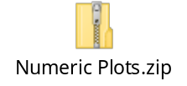
Numeric Quantities Analysis
1) 4365 number of time (highest), appliances contributed an energy level of 50
2) 15252 times the lights were off, the reason is unknown
3) Variables RH1, T2 and RH5 are skewed towards left while RH2, Press_mm_hg and RH_out are skewed on right
4) The visibility was 40 for most of the data(7232 count)
5) Outliers can be seen for the graphs of Appliances, RH1, T2, RH2, RH3, T5, Windspeed, Visibility clearly

Slide 8
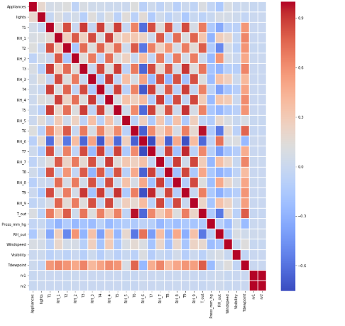
Interdependency between data using Correlation Matrix

Slide 9
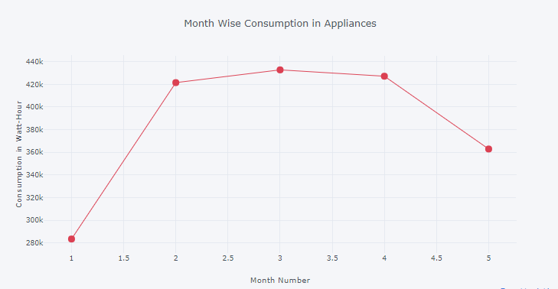
Time Series Analysis of Appliance Energy Consumption
  The highest consumption was done during 2nd and 3rd month

Slide 10
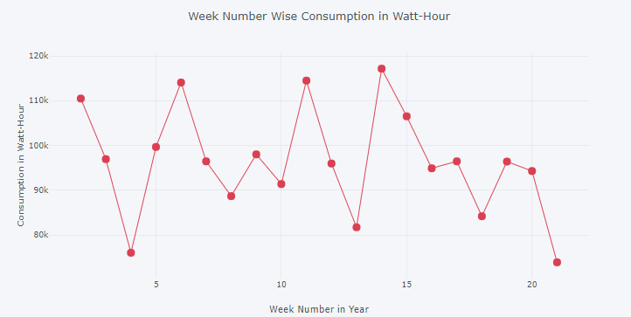
Time Series Analysis of Appliance Energy Consumption
  The highest consumption was on 14th week followed by 11th week and the least consumption was on 21st week the last week of May

Slide 11
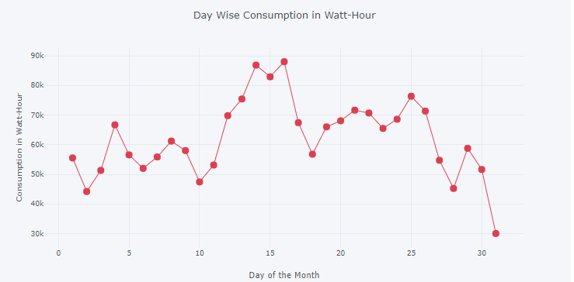
Time Series Analysis of Appliance Energy Consumption
  Energy was consumed the highest on 14th, 15th and 16th day across all the month

Slide 12
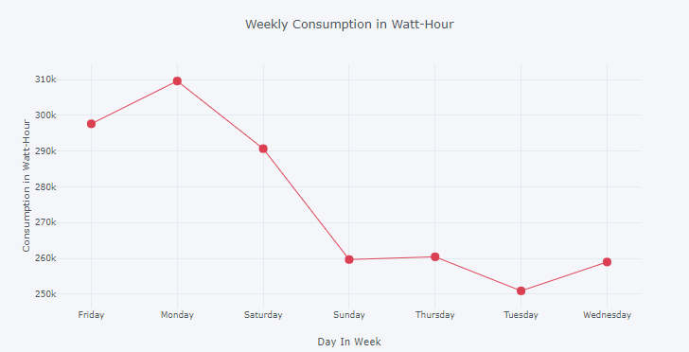
Time Series Analysis of Appliance Energy Consumption
  It is very clear that on Mondays appliances consumed the highest energy followed by Fridays

Slide 13
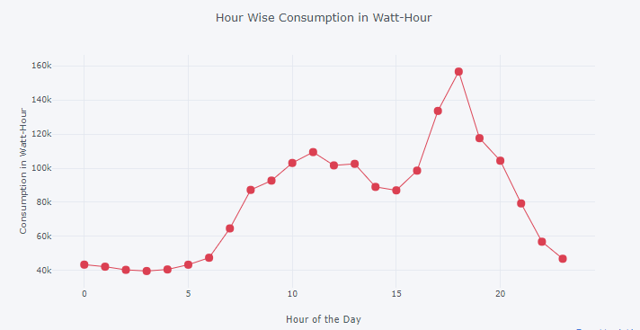
Time Series Analysis of Appliance Energy Consumption
  Highest consumption of energy is observed from 5pm to 7pm throughout.
  Also, it can be observed that the energy consumption starts everyday in the morning at 5 am and there is very less in the mid night

